Slide 1
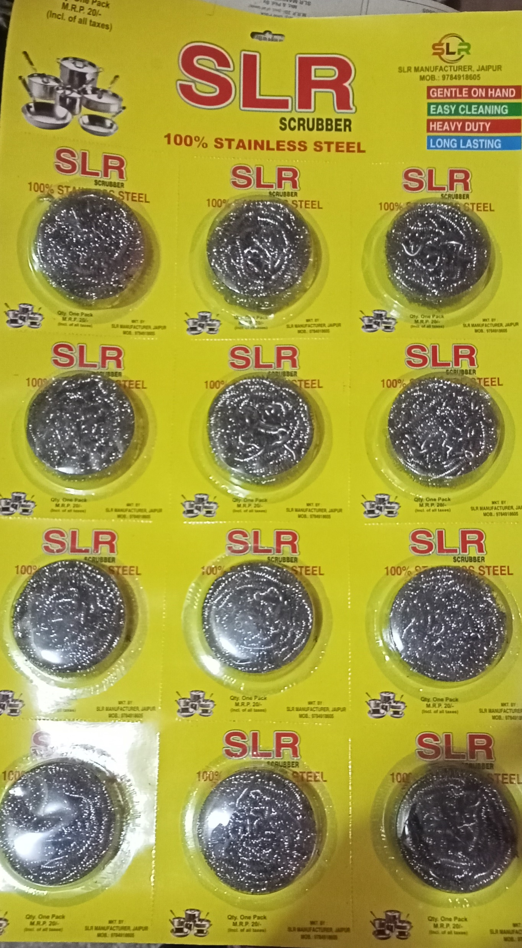
BDM Capstone Project
Strategic Solution for Dish Washing
(Scrubber) Business problem
Name: Himanshu Choudhary
Roll number: 22f1001119

Slide 2
Executive Summary
The business data management capstone project focuses on SLR Scrubber Sales Company, a thriving wholesale shop in Jaipur District, Rajasthan, India. Founded three years ago, the company operates on a B2B model and has gained a strong market presence due to its efficient business model. SLR specializes in distributing scrubber products, with their main product being Steel Scrubber, alongside other varieties like Plastic Scrubbers, Foam Scrubbers, Steel Foam Scrubbers, and Green Scrubber pads.

Slide 3
Problems Associated
a) Delivery Challenges: SLR Scrubber Sales Company faces logistical challenges in efficiently delivering products to diverse locations.
b) Product Quantity Planning: The company struggles to determine the right quantity of Steel scrubber products for sales visits, aiming to meet customer demands while avoiding excess inventory and stockouts.

Slide 4
Problems-Solving Approach
For Delivery Challenges
For Product Quantity Planning
Identify challenges in product delivery to diverse locations.
Develop optimized strategy focusing on profitable villages for improved efficiency.
Determine optimal quantity of Steel Scrubbers for sales visits.
Use data-driven analysis and statistical techniques to strike a balance between customer demand and inventory management.

Slide 5
Swot Analysis
Strengths
Challenges in delivering products to diverse locations efficiently.
Threats
Increasing competition from other scrubber product suppliers.
Opportunities
Potential for strategic focus on high-revenue villages for improved delivery.
Established reputation as a reputable supplier of scrubber products.
Weakness
Strong presence in the market with successful B2B operations.
Market fluctuations and changes in customer preferences.
Difficulty in determining the optimal quantity of products for sales visits.
Use of data-driven approaches to optimize inventory management and sales strategies.

Slide 6
Results and Findings
Strong positive correlation (0.825) between profit and revenue, indicating that increasing revenue leads to higher profits and vice versa.
Top 14 profitable regions contribute to approximately 67% of the total net profit, mid-tier 14 profitable regions contribute around 23% and bottom 14 profitable regions contribute around 10% .
Stable demand trend for Steel Scrubbers with an average sales quantity of around 51 packets over a 3.5-month period.
The average daily sales quantity of 49.728 Steel Scrubber packets. Sales exhibit a symmetrical distribution with the 25th, 50th, and 75th percentiles all at 51, indicating a consistent sales trend. However, potential outliers contribute to a standard deviation of 7.12, with minimum and maximum sales at 24 and 86 packets, respectively.

Slide 7
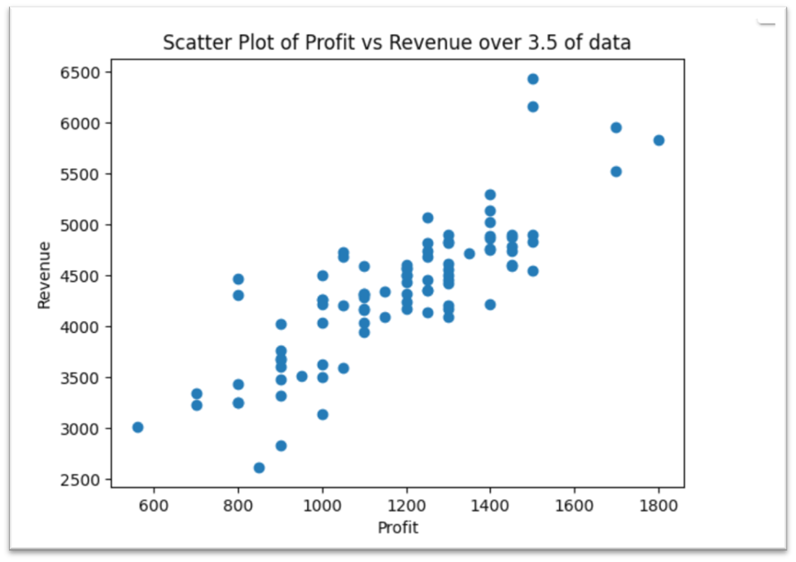
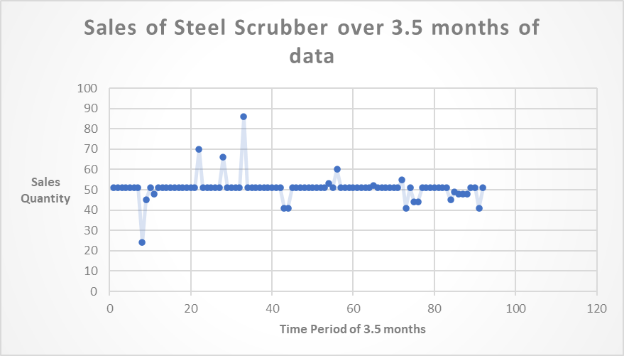
DASHBOARD

Slide 8
Suggestions
Utilize the correlation between profit and revenue to guide strategies aimed at maximizing overall profitability.
Prioritize the top 14 profitable regions and mid-tier 14 profitable regions for resource allocation and marketing efforts.
Maintain a sales quantity of approximately 51 packets of Steel Scrubbers during sales visits based on the consistent demand.
Encourage shop owners to place pre-orders for Steel Scrubbers to streamline inventory management and reduce carrying costs.
Regularly monitor and analyze sales data, profitability trends, and customer preferences to make data-driven decisions for sustainable growth.

Slide 9
End

